Slide 1
Linux GUI

Slide 2
Desktop Environment
X Windows – aka X11 – X.org
GUI Framework – Windowing System
Architecture Independent
Network protocol built into service
Designed to be used over network connections
Client / Server relationship is “reversed”
Server accepts graphical output (Windows) from client
Server sends user input (keyboard / mouse / touch) to the client

Slide 3
Window Managers
Controls placement and appearance of Windows within the GUI
No additional software included
Common X Window Managers:
Compiz
Kwin
Metacity
Enlightenment
MANY other

Slide 4
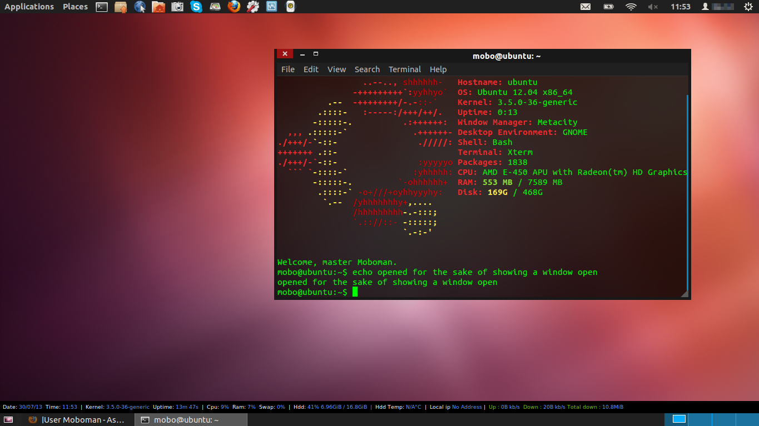
Desktop Environments
GNOME:
Desktop Environment
Window Manager = Mutter
Includes extensive software packages
Free and Open Source
Part of GNU Project
Wide Distribution
Red Hat / Fedora / CentOS
Debian / Ubuntu / Kali
Oracle Linux
SteamOS

Slide 5
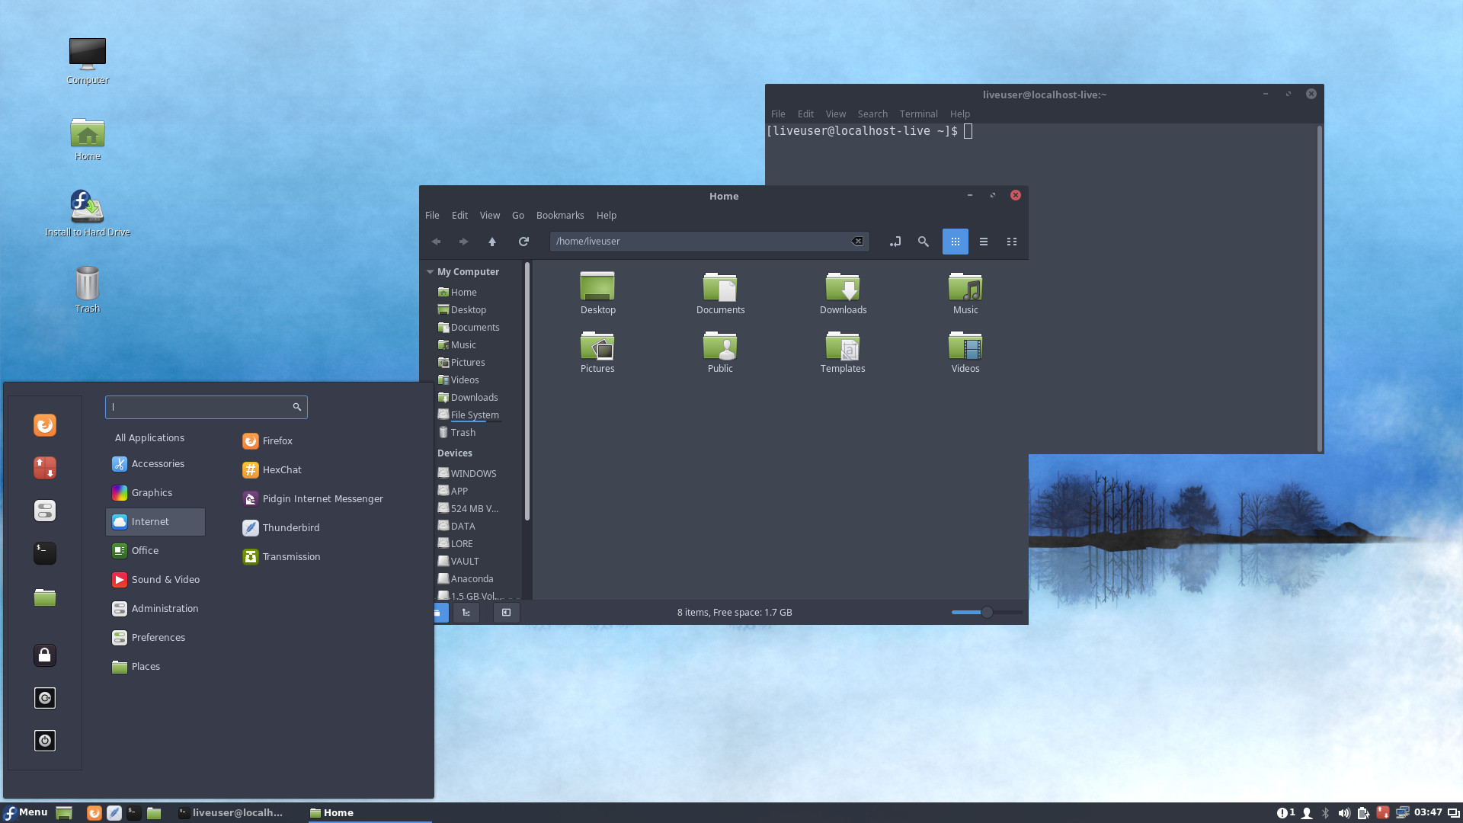
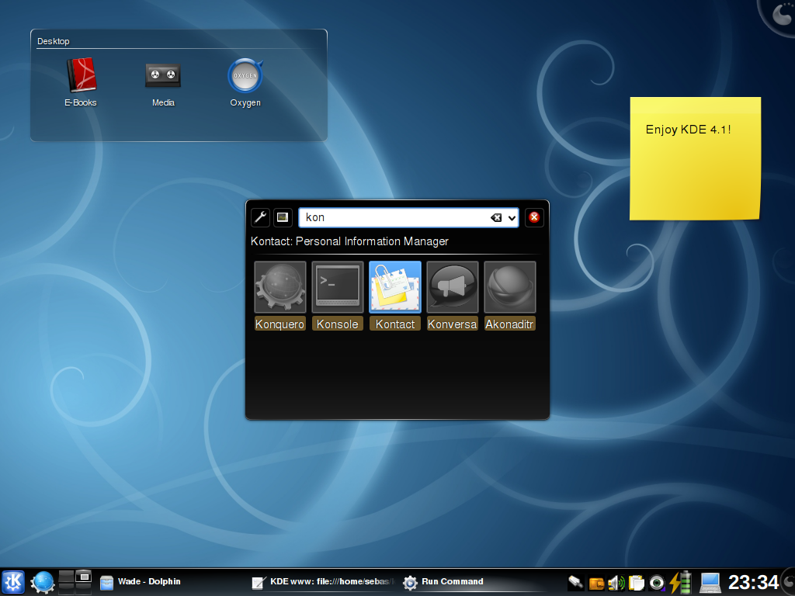
GNOME Alternatives
Cinnamon
Based on GNOME, distributed with Linux Mint
KDE
Free desktop environment
Broad support from development community
KDE Plasma – current Workspace based desktop environment
MANY KDE developed utilities and tools
Wide distribution support
Arch Linux / Debian / Kubuntu / Linux Mint
FreeBSD / Gentoo / OpenSUSE
Windows!

Slide 6
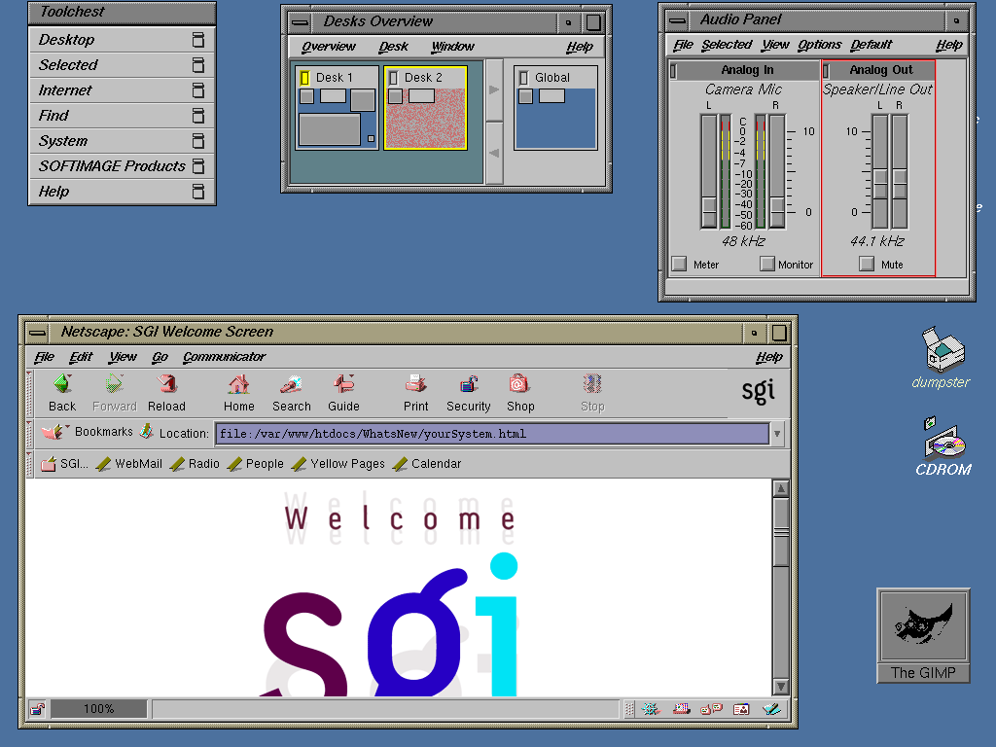
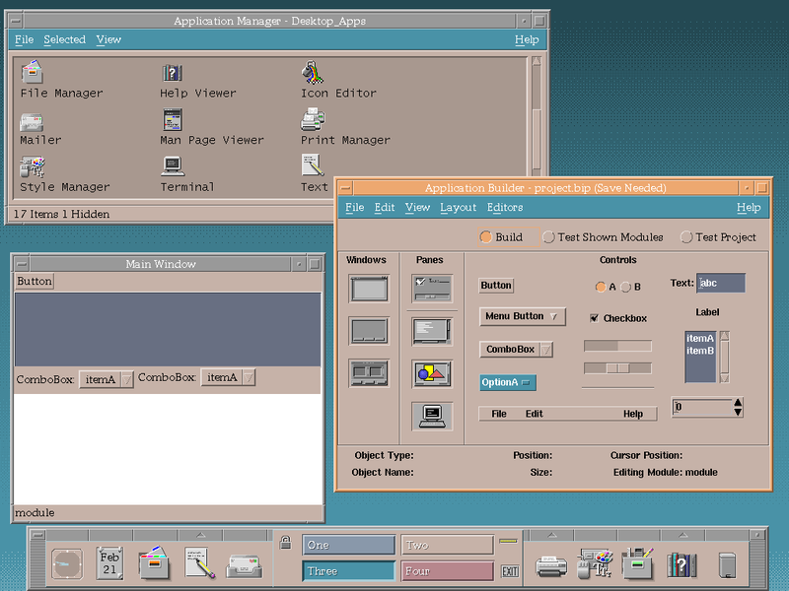
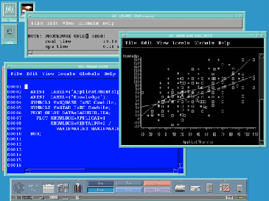
GNOME Alternatives
UNIX Desktop Environments
CDE – HP / IBM / Solaris / USL / OpenVMS
VUE – HP-UX
IRIX – Silicon Graphics (SGI)

Slide 7
GNOME Lab
Perform the lab as per the provided instructions.

